Slide 1
Relationships among Lexemes & senses
Homonymy: same spelling or pronunciation but different meanings.
Bat (an animal) vs. Bat (a tool used in sports like cricket or baseball), bank (financial institution) vs bank (riverside)
2. Polysemy: A word with multiple related meanings.
Get – receive; reach; understand, Crane – bird; construction equipment
3. Synonymy: Words with nearly the same meaning.
happy/joyful, big/large, couch/sofa, vomit/throw up
4. Antonymy: Words with opposite meanings.
dark / light, short / long, hot / cold, up / down, in / out
5. Hypernymy/Superordinate: A word that is more generic and can encompass a broader category.
Animal is a hypernym of Dog because "animal" is a broader category that includes dogs, vehicle is a hypernym of car, fruit is a hypernym of mango.
6. Hyponymy/Subordinate: A more specific term under a broader category.
Dog is a hyponym of Animal because it's a specific kind of animal, car is a hyponym of vehicle, mango is a hyponym of fruit
Hyponymy/hypernymy is transitive: if A is a hyponym of B and B is a hyponym of C, then A is a hyponym of C.
7. Meronymy: A part-whole relationship between words.
Wheel is a meronym of Car because a wheel is part of a car, A wife has a husband. A husband is a part of a wife, A sound has a pitch and a volume. A volume is a part of a sound, A book has pages.A page is a part of a book

Slide 2
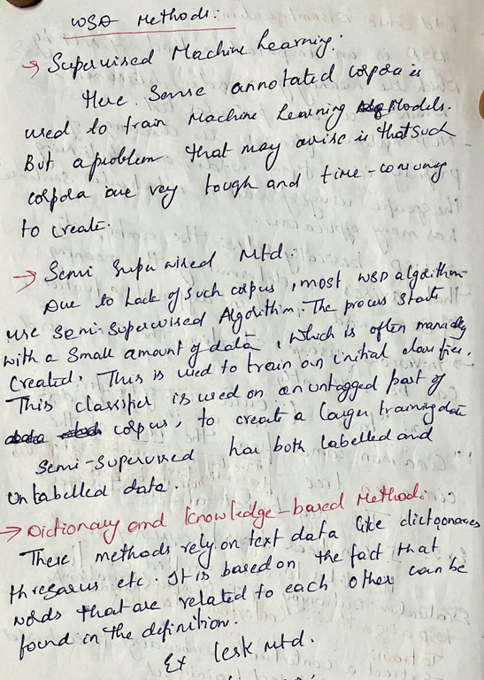
WSD Methods
Supervised Machine Learning:
a training corpus of words tagged in context with their sense
used to train a classifier that can tag/classify words in new text
Thesaurus/Dictionary Methods: Lesk method
Semi-­‐Supervised Learning:
Supervised and dictionary-­based approaches require large hand-­built resources. What if you don’t have so much training data? Solution: Bootstrapping - Generalize from a very small hand-­‐labeled seed-­‐set. Example: for bass: Rely on “One sense per collocation” rule - A word reoccurring in collocation with the same word will almost surely have the same sense. the word play occurs with the music sense of bass the word fish occurs with the fish sense of bass

Slide 3
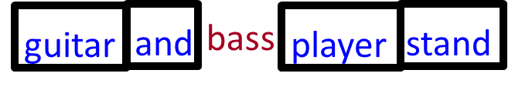
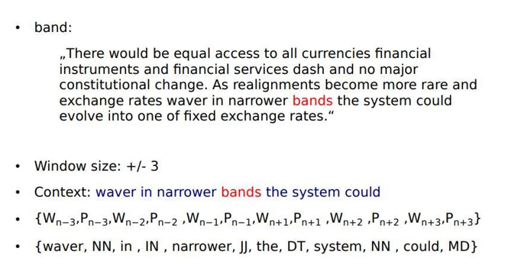
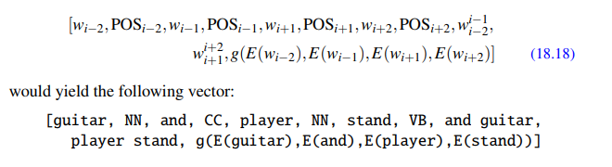
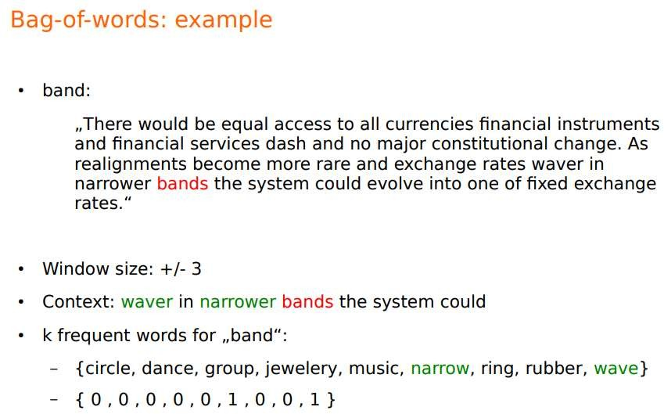
Collocational Feature Vectors: Features about ordered words at specific positions near target word
Bag-­‐of-­‐words Feature Vectors : Features about unordered words that occur anywhere in the window (regardless of position)
Assume we’ve settled on a possible vocabulary of 12 words in “bass” sentences: [fishing, big, sound, player, fly, rod, pound, double, runs, playing, guitar, band]
The vector for: guitar and bass player stand is [0,0,0,1,0,0,0,0,0,0,1,0]
Assume a window of +/-­‐ 2 from the target ‘bass’ Assume a window of +/-­‐ 2 from the target ‘bass’

Slide 4
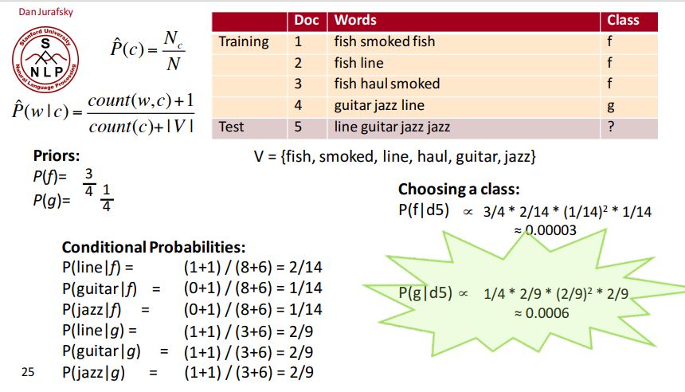


SUPERVISED ML – naïve bayes for text classification
LAPLACE SMOOTHING
Unique words = |V| = 6
Square because jazz is occurring twice in the test case

Slide 5
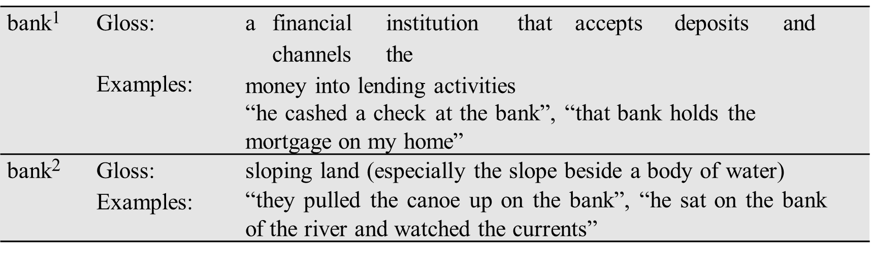
Simplified Lesk algorithm
Labelled corpora is expensive and difficult
While supervised algorithms generally work better, knowledge-based methods which rely solely on knowledge-based wordnet, don’t require labeled data.
Lesk is a family of algorithms that choose the sense whose dictionary gloss/definition shares the most words with the target word’s neighborhood.
Let’s disambiguate “bank” in this sentence: The bank can guarantee deposits will eventually cover future tuition costs because it invests in adjustable- rate mortgage securities.
given the following two WordNet senses:

Slide 6
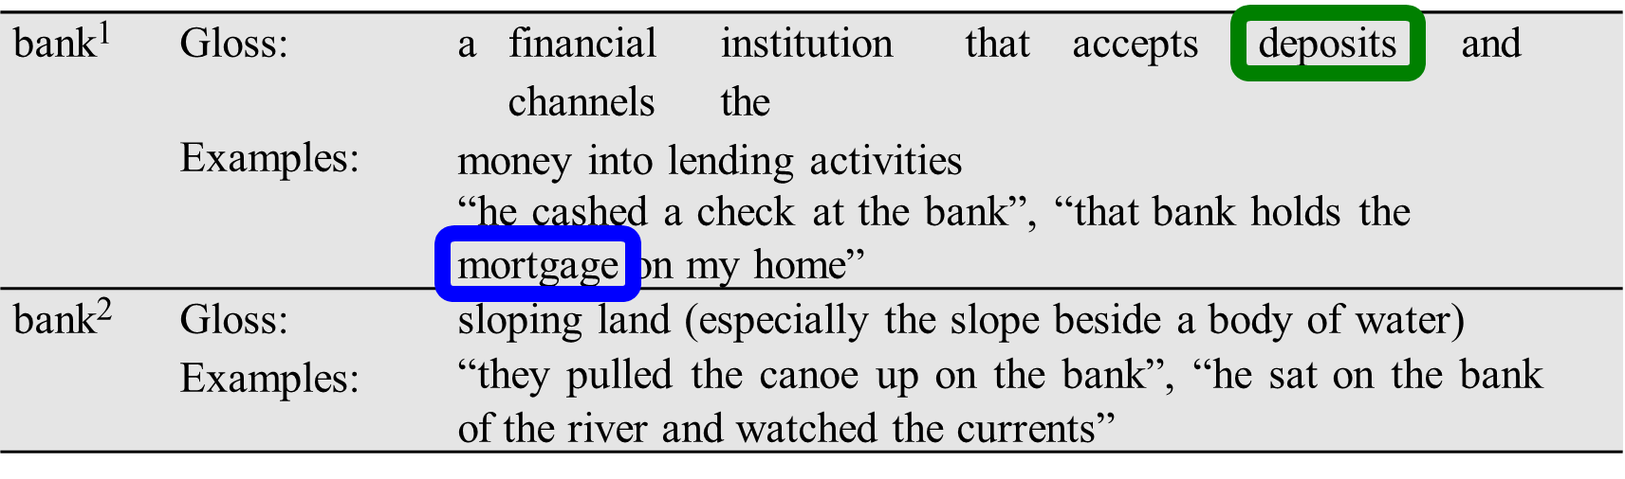
The Simplified Lesk algorithm
Choose sense with most word overlap between gloss and context
(not counting function words)
The bank can guarantee deposits will eventually cover future tuition costs because it invests in adjustable-­‐rate mortgage securities.

Slide 7
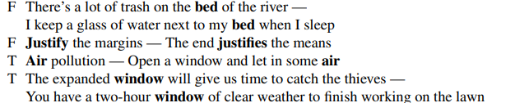
WSD -Word-in-Context Evaluation
Here the system is given two sentences, each with the same target word but in a different sentential context. The system must decide whether the target words are used in the same sense cluster (marked True) in the two sentences or in a different sense ( marked False)

Slide 8
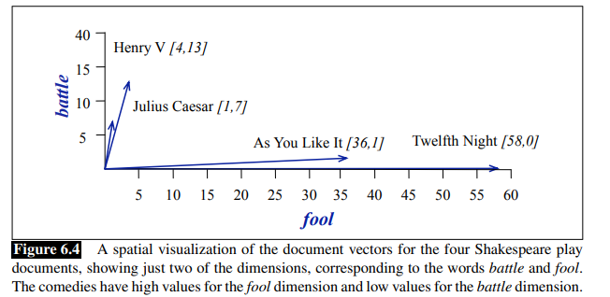
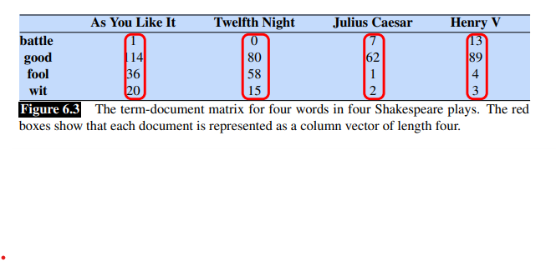
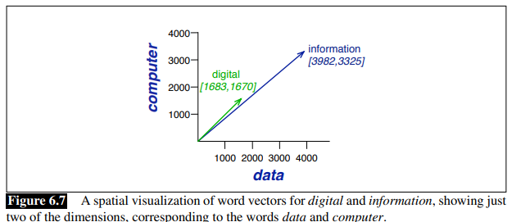
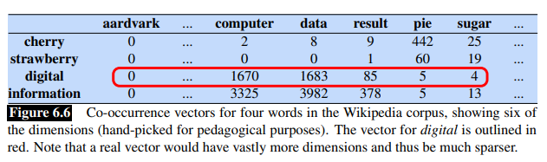
WORD SIMILARITY
Vectors and documents: vector semantics is to represent a word as a point in a multidimensional semantic space from the distributions of embeddings word neighbors.
DOCUMENTS
Term – document matrix
WORDS
Word – word matrix/ word-content matrix

Slide 9
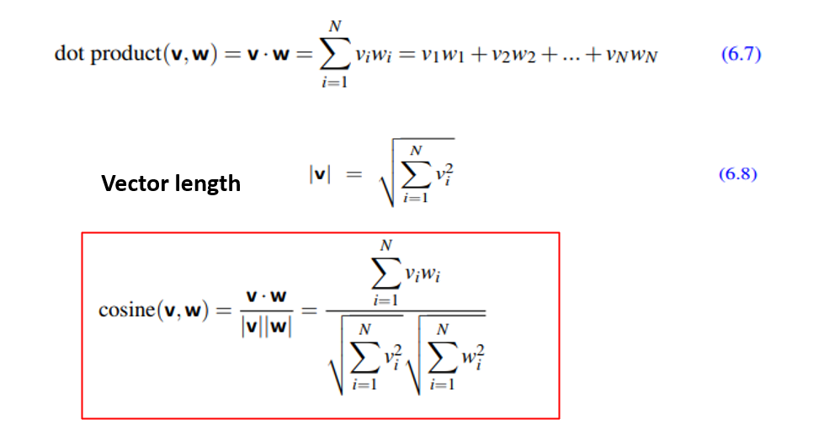
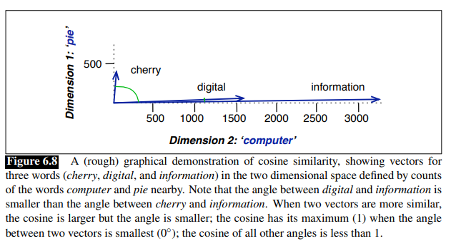
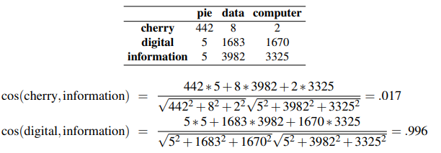
Cosine for measuring similarity

Slide 10
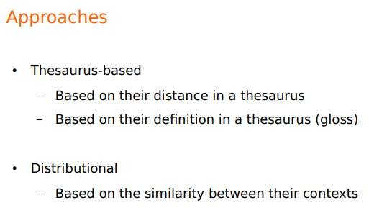
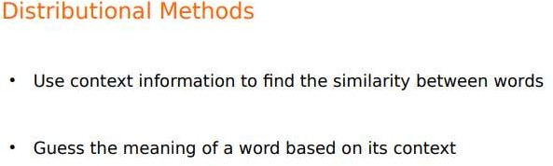
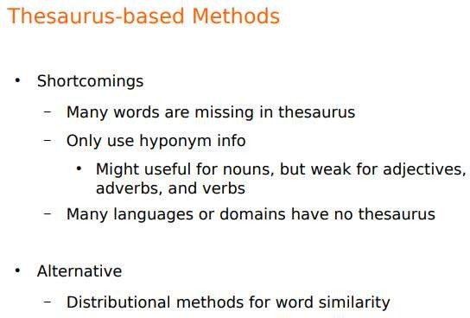
Word Similarity analysis using Thesaurus and Distributional methods

Slide 11
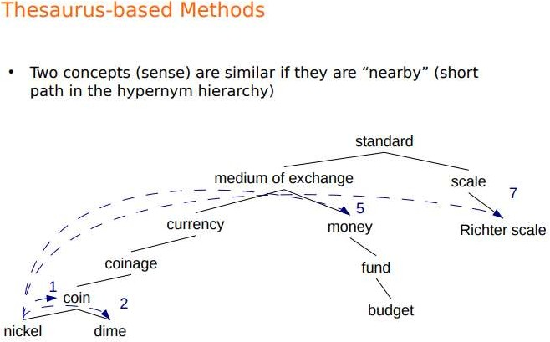
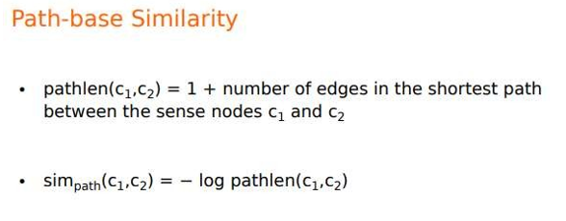

Slide 12
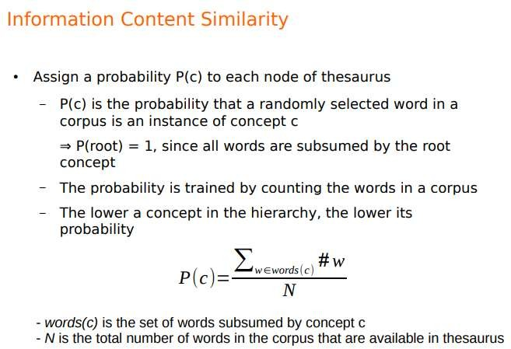

Slide 13
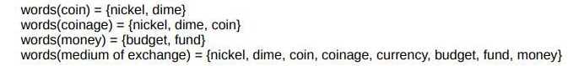
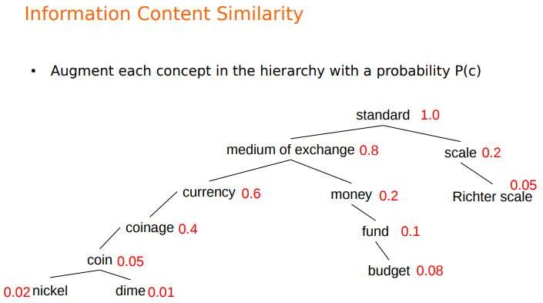

Slide 14
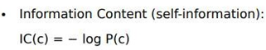
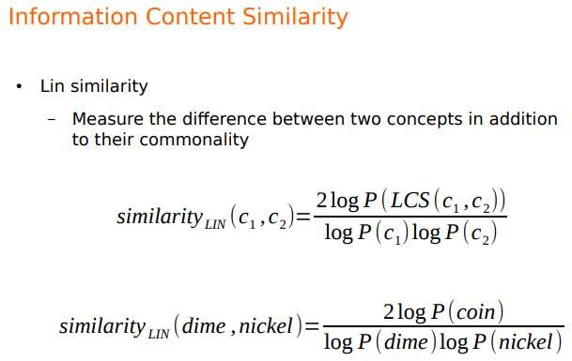
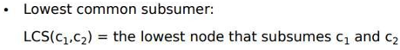
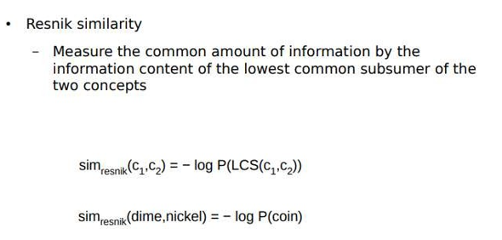
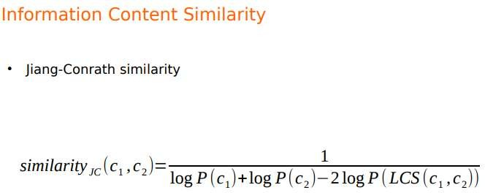

Slide 15
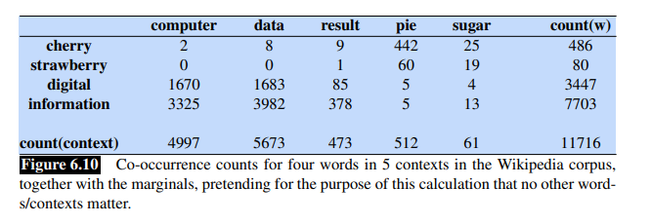
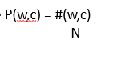
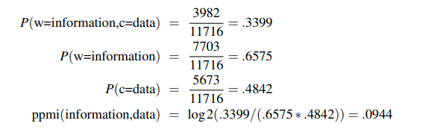
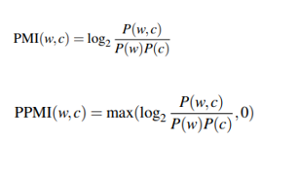
DISTRIBUTIONAL SIMILARITY: Pointwise Mutual Information (PMI)
PMI : It is a measure of how often two events x and y occur, compared with what we would expect if they were independent
PPMI (Positive PMI) : replaces all negative PMI values with 0
COMPUTE: PPMI(w=information,c=data)

Slide 16
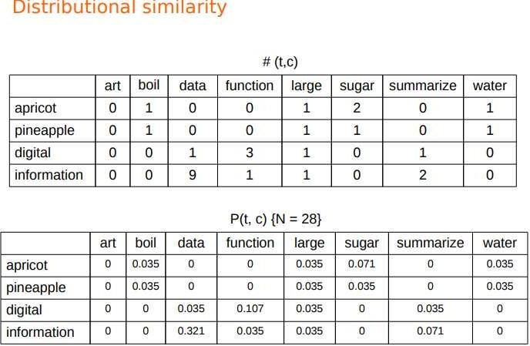
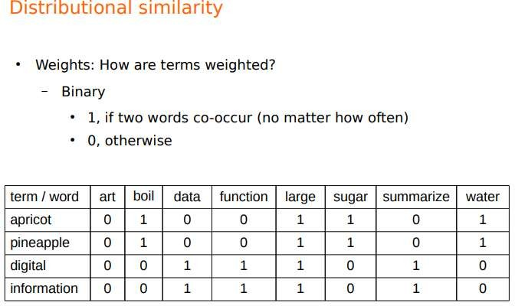
Apricot, boil = 1/28 =0.035
Apricot, sugar = 2/28 = 0.071
Digital, information = 3/28 = 0.107
Information, data = 9/28 = 0.321

Slide 17
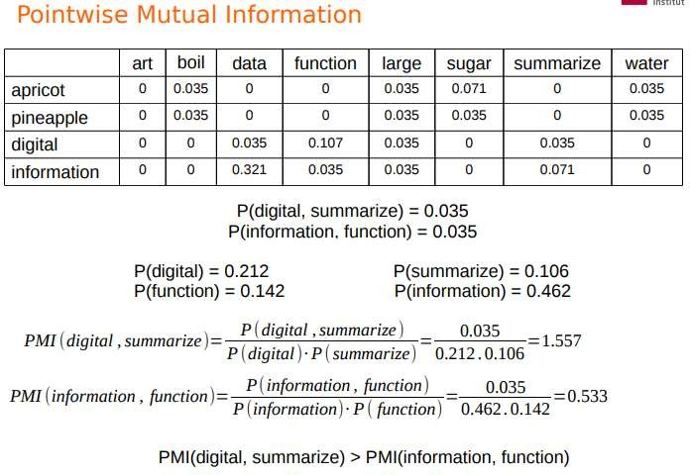
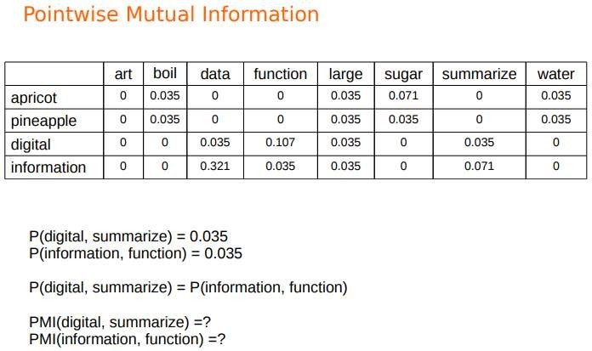
(0+0+0.035+0.107+
0.035 + 0 + 0.035 +0 = 0.212

Slide 18
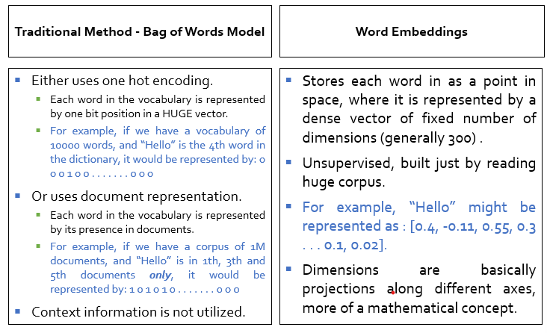

Slide 19
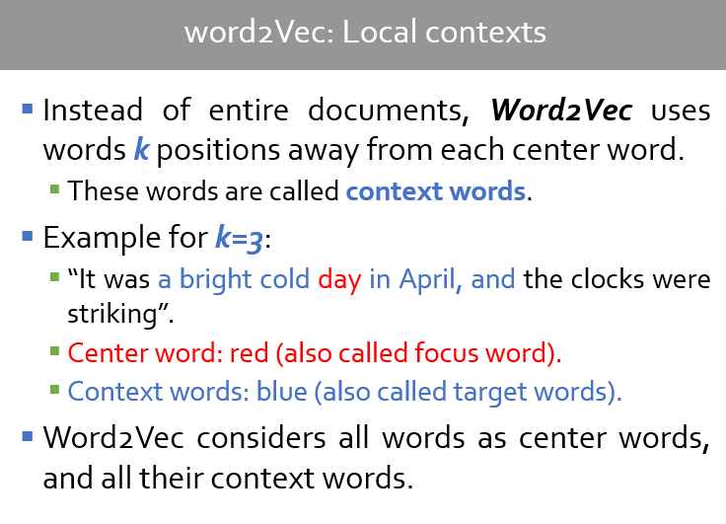

Slide 20
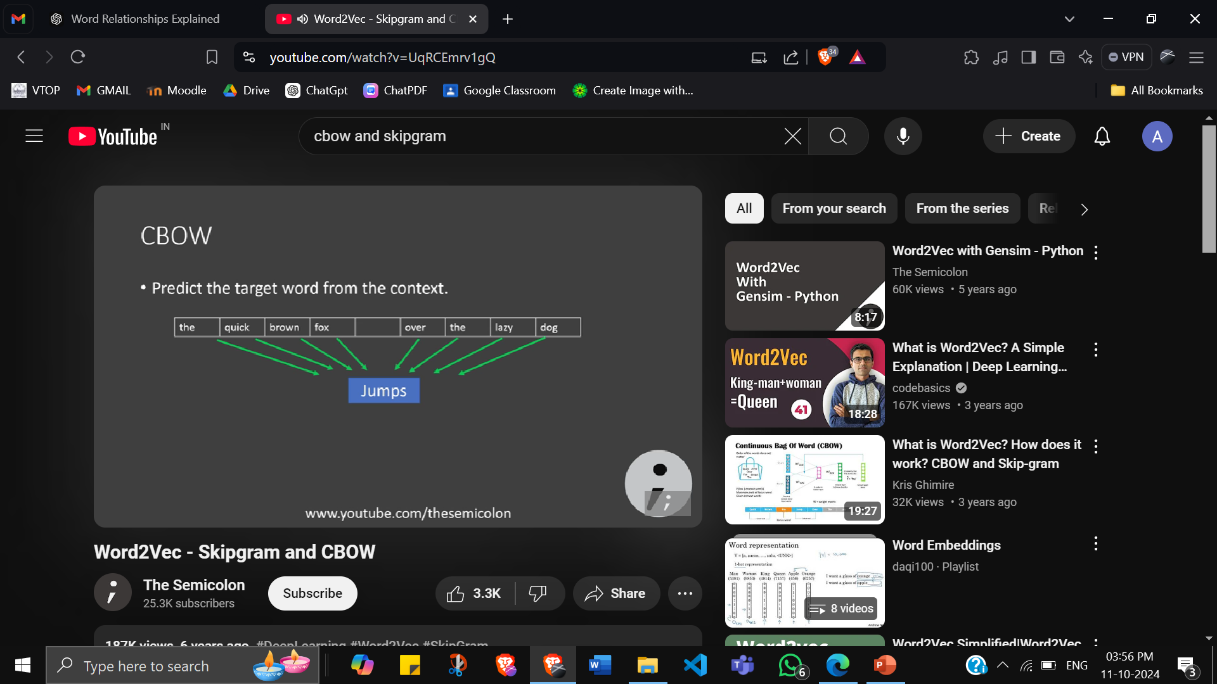
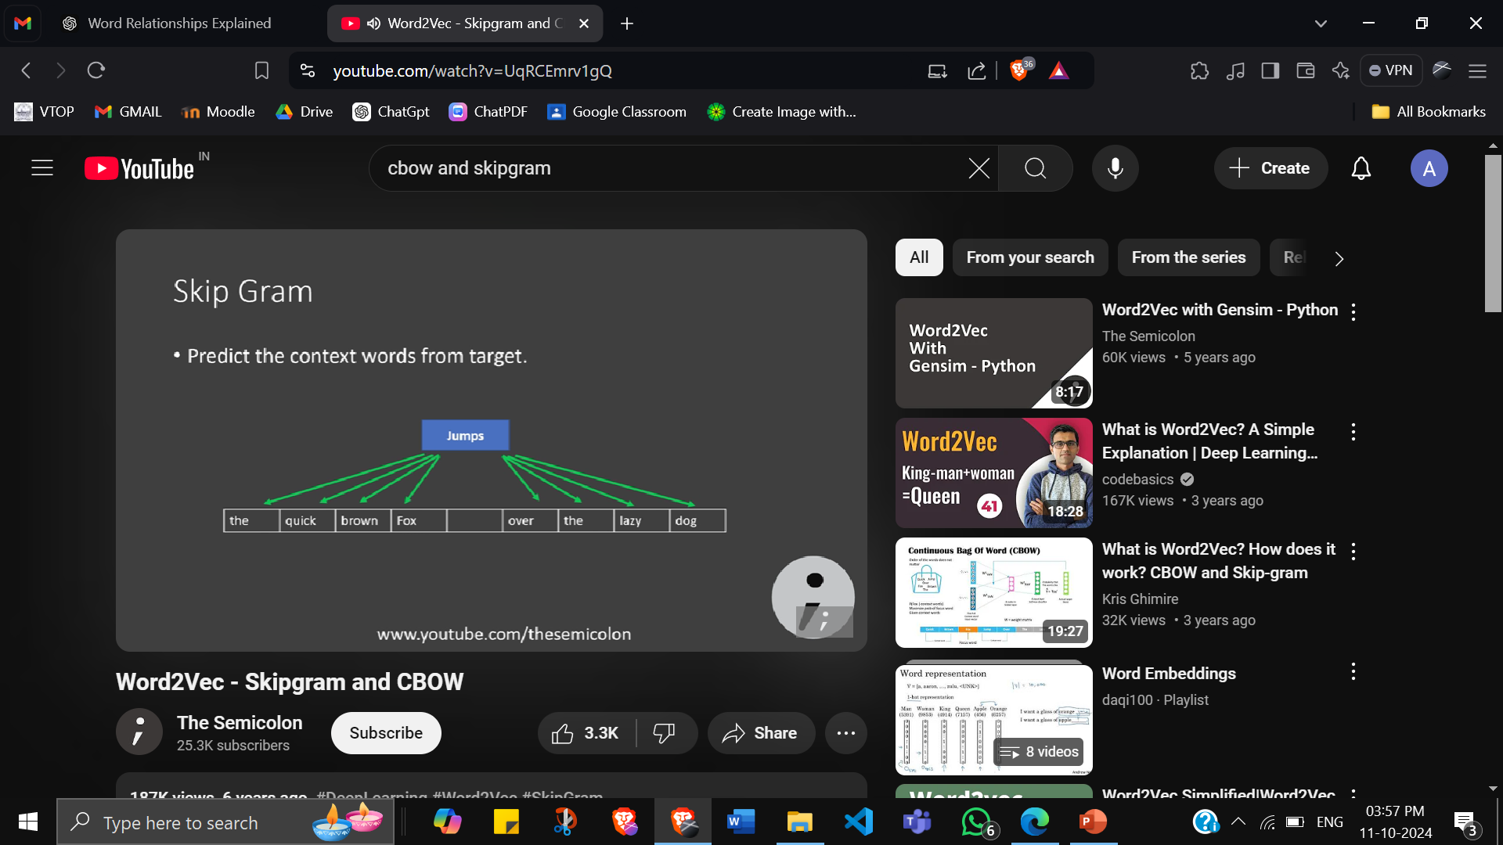
WORD2VEC
Word embeddings: representing words in number
Preserves relations between words
Useful in deep learning
WORD EMBEDDING
FREQUENCY
PREDICTION
TF-IDF
Co-Occurence matrix
CBOW (Continuous bag of words)
Skip Gram

Slide 21
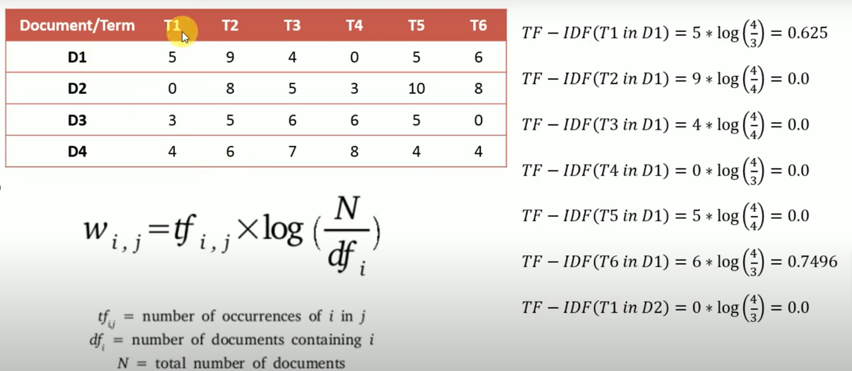
TF-IDF (Term Frequency – Inverse Document Frequency)

Slide 22
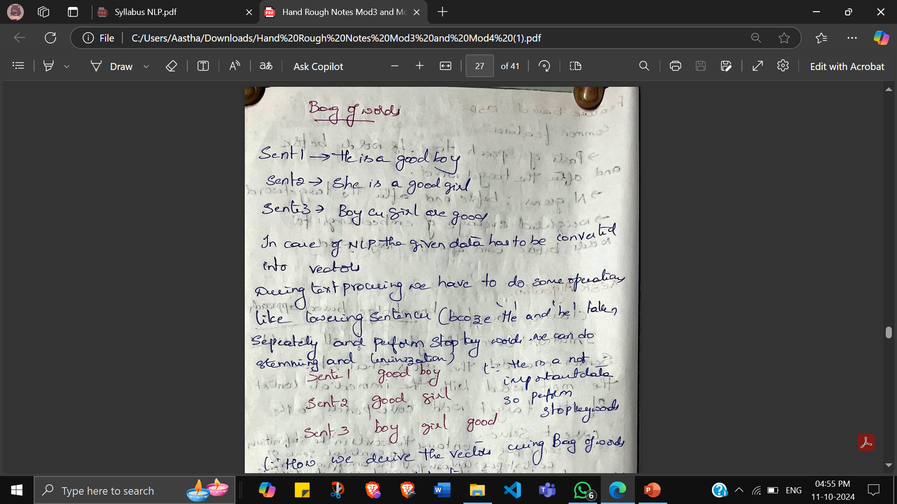
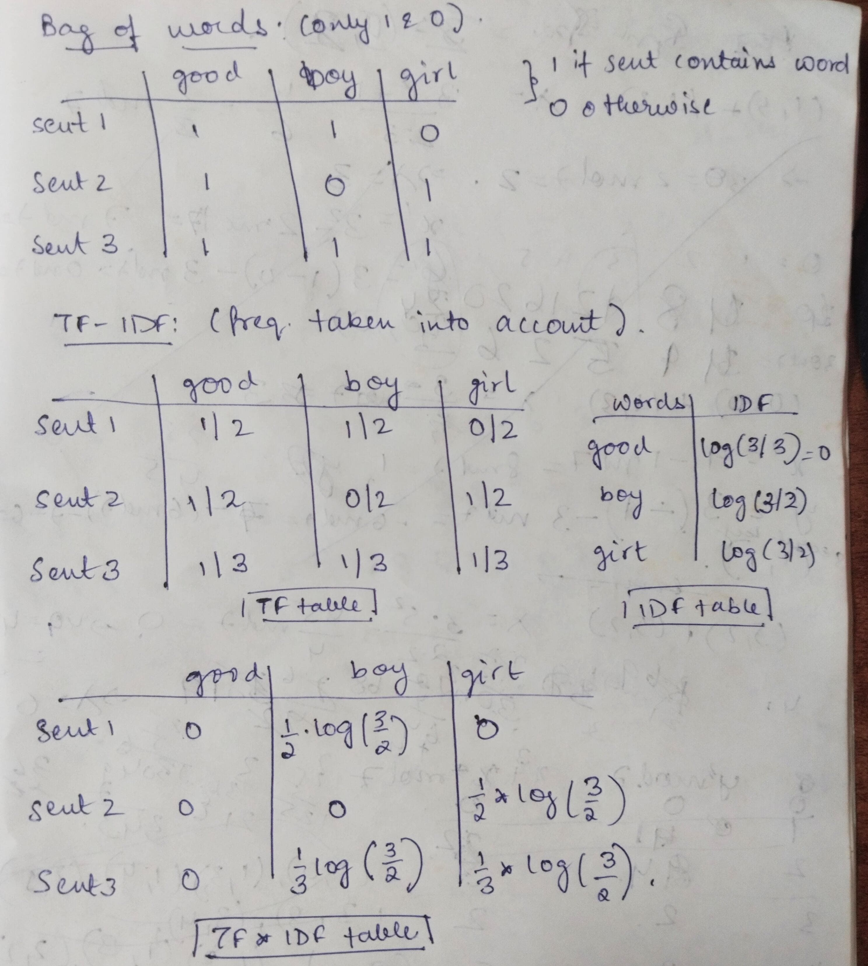

Slide 23
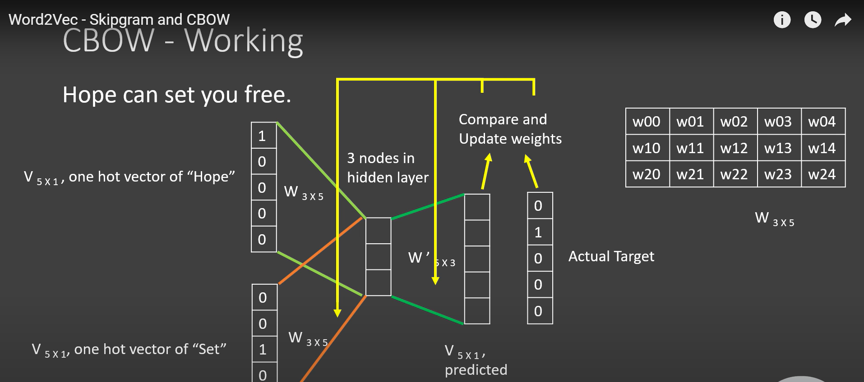
https://youtu.be/jKUwzgzdz3U?si=vU5ODOZUvhH7svxL
Large corpus, slower

Slide 24
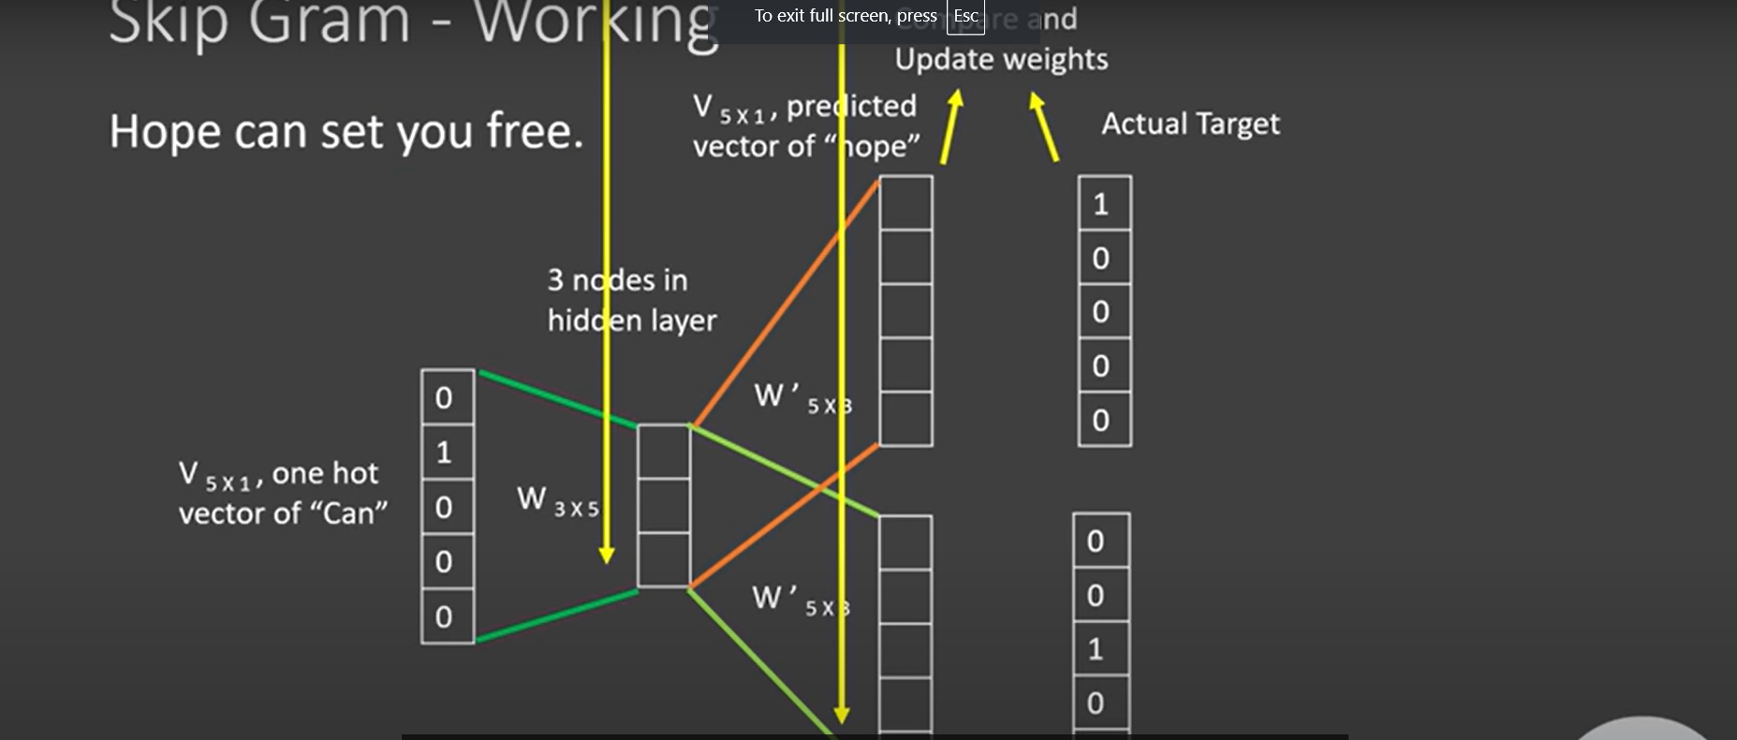
Small corpus, faster

Slide 25
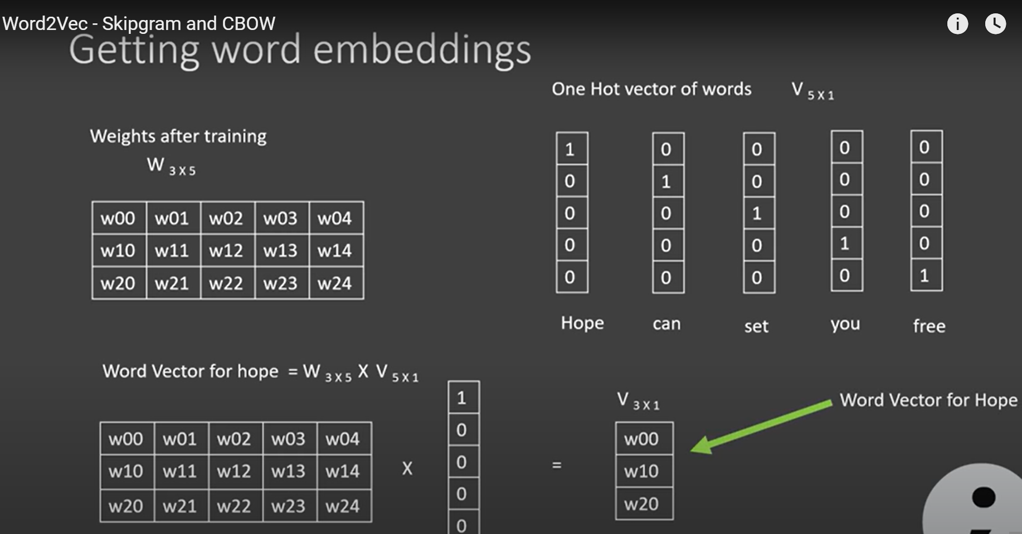

Slide 26
LIMITATIONS OF WORD2VEC
Out of Vocabulary(OOV) Words: In Word2Vec, an embedding is created for each word. It can’t handle any word it has not encountered during its training.
For example, words such as “tensor” and “flow” are present in the vocabulary of Word2Vec. But if you try to get embedding for the compound word “tensorflow”, you will get an out of vocabulary error.
Morphology: For words with same radicals such as “eat” and “eaten”, Word2Vec doesn’t do any parameter sharing.
Each word is learned uniquely based on the context it appears in. Thus, there is scope for utilizing the internal structure of the word to make the process more efficient.

Slide 27
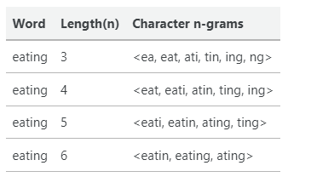
FASTTEXT
FastText is an NLP library developed by the Facebook research team for text classification.
FastText is popular due to its training speed and accuracy.
each word is represented as a bag of character n-gram.

